Slide 2
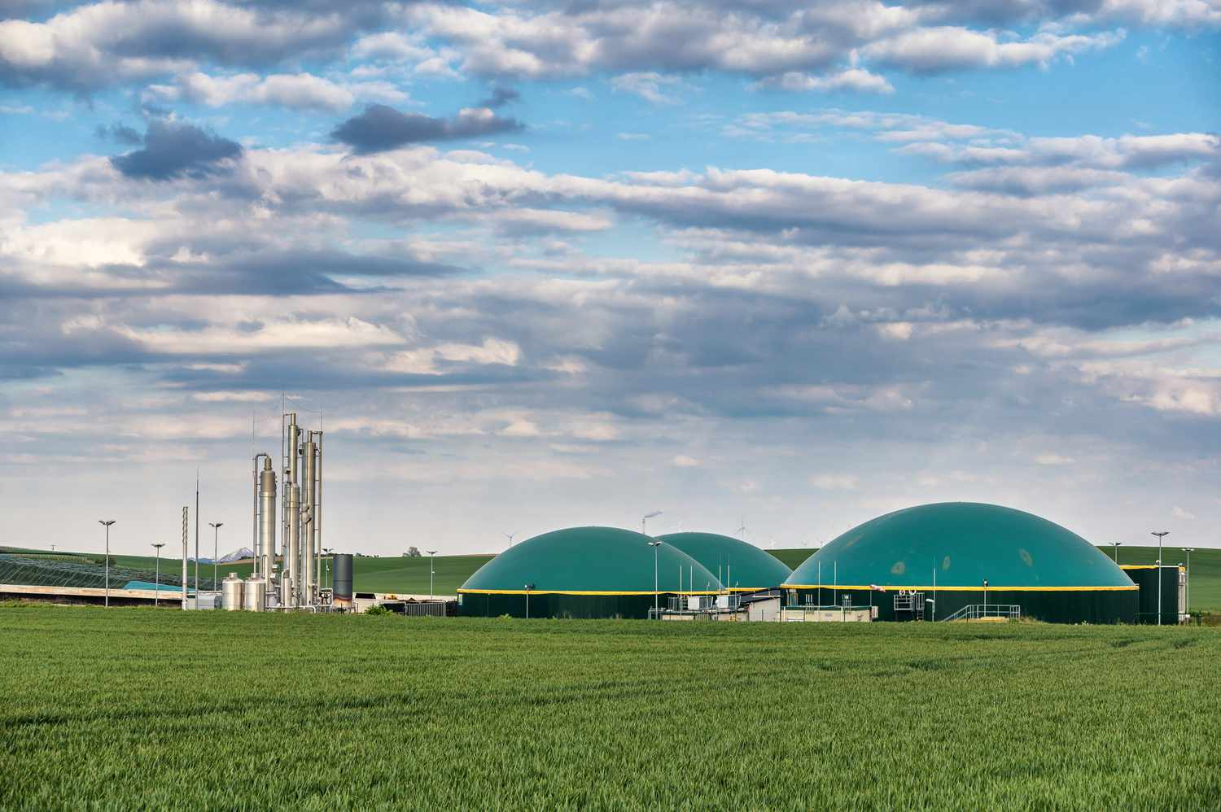
•~CONTENTS~•
Biogas plant
What is biogas
Factors affecting biogas generation
Biogas potential in India
Evolution of biogas in India
Types of biogas plant
Current status of biogas in India
Future plans of India in biogas
Advantages, uses, application, limitations of biogas

Slide 3
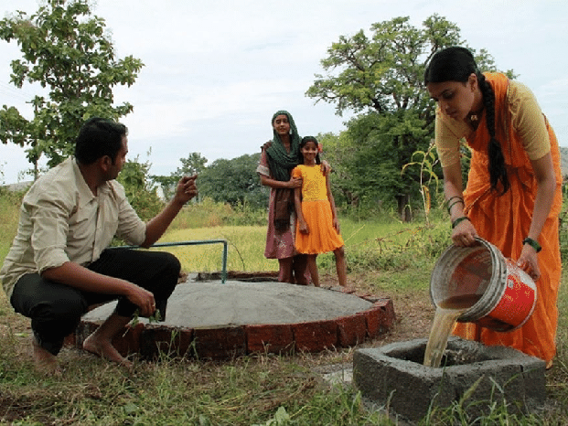
Biogas plant
•Also called as 'Biogas Digester’, ‘Biogas Reactor’, ‘Methane Generator'
•Biogas plant is an airtight container that facilitates fermentation of material under anaerobic condition
•Recycling and treatment of organic wastes (biodegradable material) through anaerobic digestion (fermentation) technology provides biogas a clean and convenient fuel and an excellent and enriched bio-manure.

Slide 4
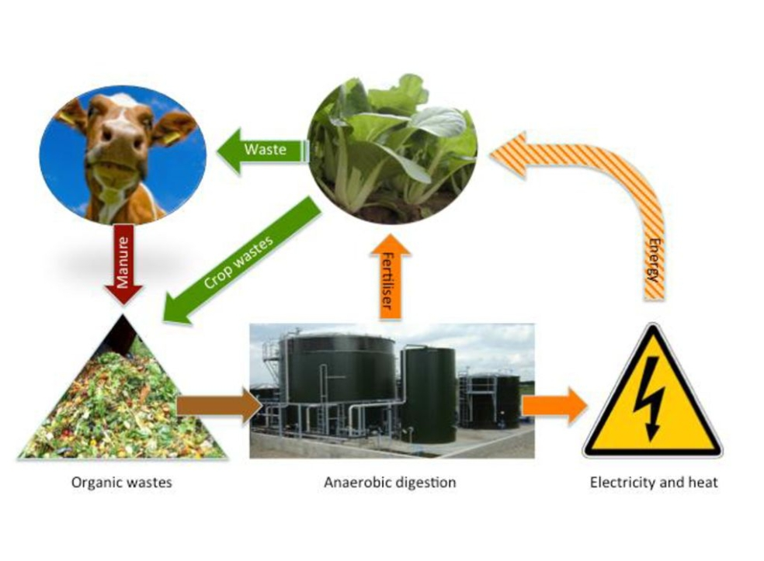
What is biogas?
Biogas is a clean and efficient fuel. It is a mixture of:
Methane (CH4)
Carbon dioxide (CO2)
Hydrogen (H2)
Hydrogen sulphide (H2S)
The chief constituent of biogas is methane (65%).

Slide 5
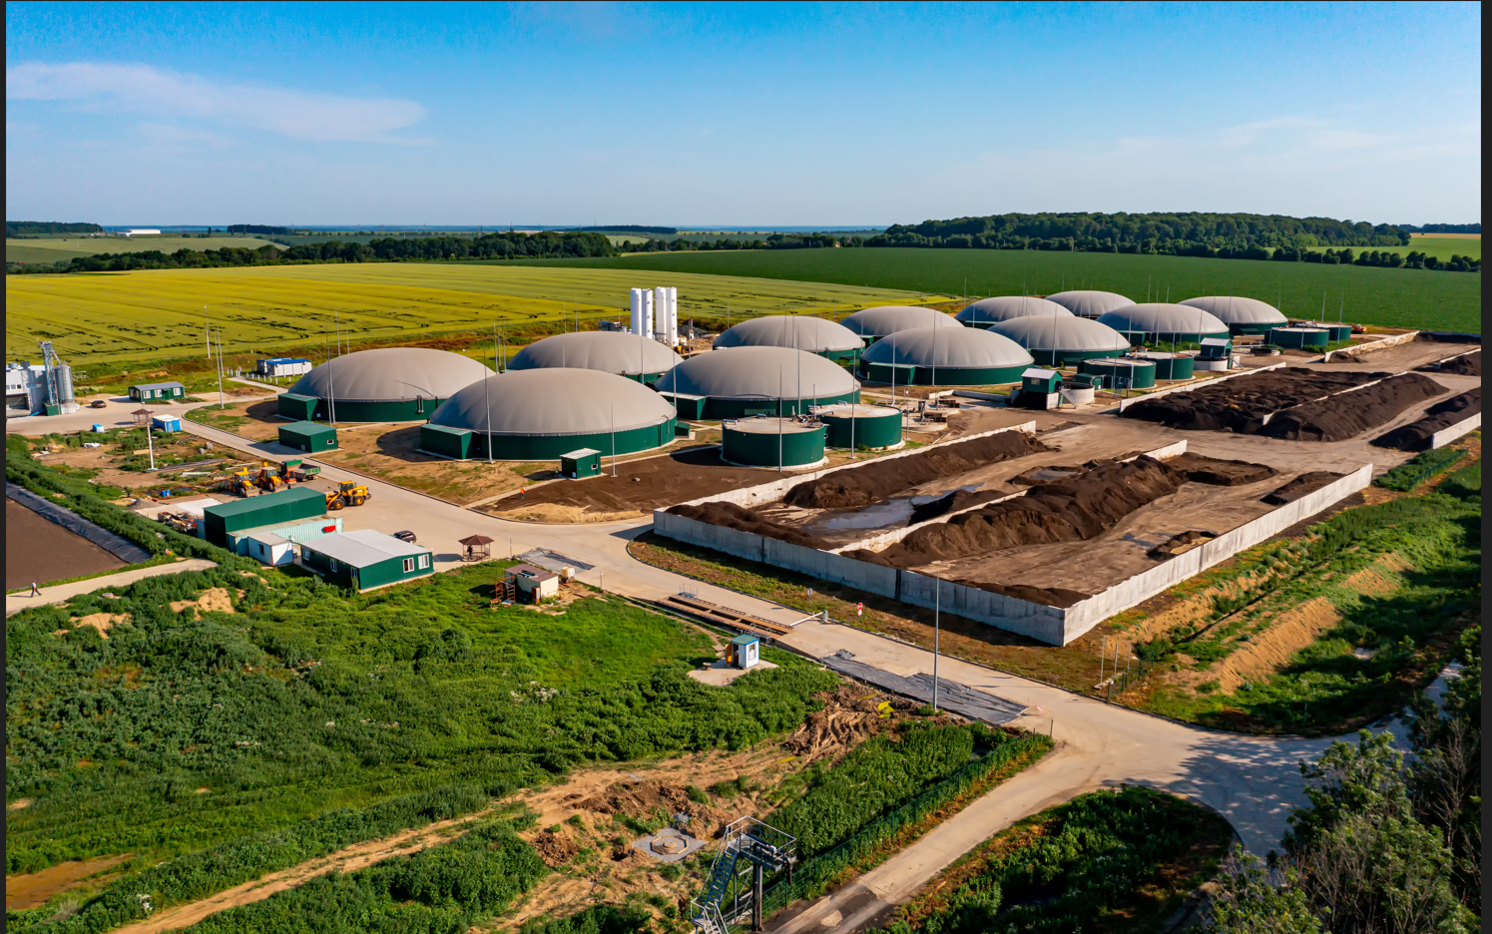
Factors affecting Biogas generation
pH concentration
Temperature
Total solid content of the feed material
Loading rate
Seeding
Uniform feeding
Diameter to depth ratio
Carbon to nitrogen ratio
Nutrients
Mixing or stirring or agitation of the digester
Retention time or rate of feeding
Type of feed stocks

Slide 6
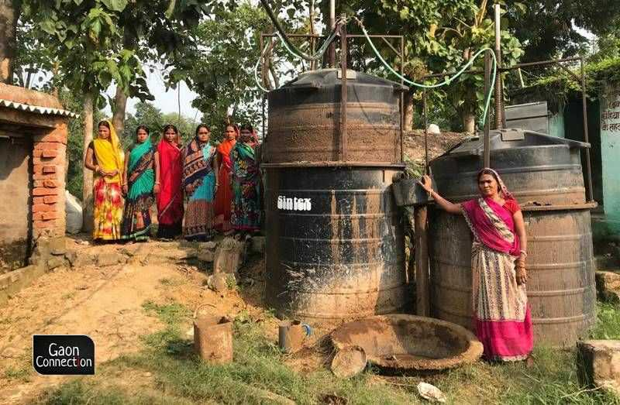
Biogas potential in india
According to the Ministry of New and Renewable Energy (MNRE), the estimated biogas potential in India is approximately 17,000 MW
The Global Methane Initiative estimates that biogas projects in India can mitigate 43 million tons of CO2e emissions annually.

Slide 7
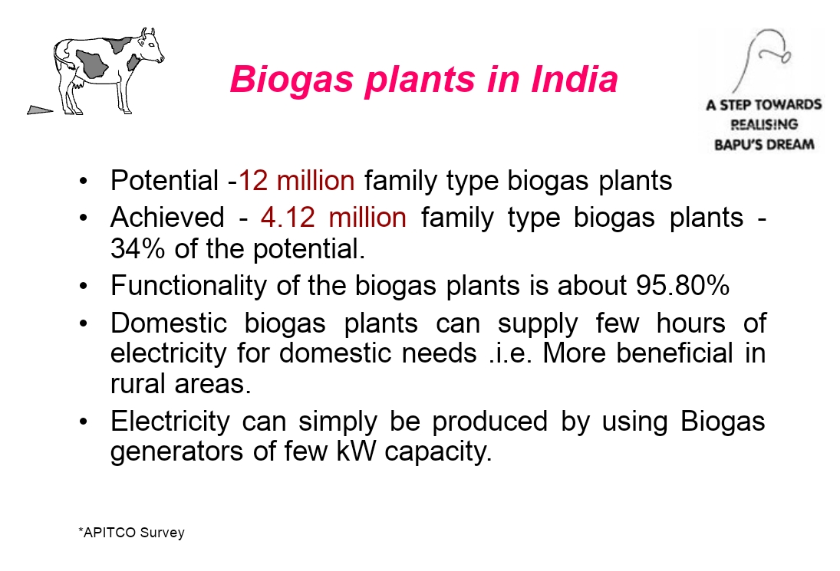

Slide 8
Evolution of biogas technology in India
Experimentally introduced in the 1930's.
First research on Sewage Purification Station at Dadar in Bombay, undertaken by S.V. Desai and N.V. Joshi of the Soil Chemistry Division, Indian Agriculture Research Institute, New Delhi.
In 1956, Jashu Bhai J Patel developed a design of floating drum biogas plant popularly known as Gobar Gas plant.
In 1961, Khadi and Village Industry Commission (KVIC) promoted Jashbhai Patel's design, which was later known as KVIC model.

Slide 9
Planning Research and Action Division (PRAD) based in Uttar Pradesh developed the 'Janata' fixed-dome plant - a modified chinese design.
Janata system is about 30% cheaper than a KVIC model.
11 Action for Food Production (AFPRO), New Delhi developed Deenbandhu model (an improved version of Janata model).
30 percent cheaper than Janata Model and 45 percent cheaper than KVIC model.Presently, designs and models are galore in market

Slide 10
Types of biogas plants
Types of biogas plants
Batch type plant. Continuous type plant
Floting Gas Holder. Fixed Dome Biogas

Slide 11
Batch Type Biogas Plant
Batch type biogas plants are appropriate where daily supplies of raw waste materials are difficult to be obtained.
Batch type plant is charged at day intervals
Once charged, it starts supplying the gas after 8-10 days and continuous to do so for about days till the process of digestion is completed. Afterwards it is emptied and recharged.
Gas production in batch type is uneven
Such plants are installed in european countries.
Donot suit the conditions in indian rural areas

Slide 12
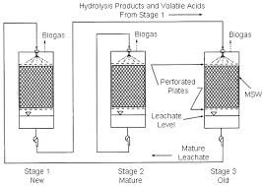
Batch Type biogas plant
https://www.researchgate.net/profile/Anil-Kumar-419/publication/283255485/figure/fig3/AS:667840499687446@1536236991989/Batch-type-biogas-plant-4.jpg

Slide 13
CONTINOUS TYPE BIOGASS PLANT
In continuous type biogas plant, the supply of the gas is continuous and the digester is fed with biomass regularly.
Plant operates continuously and is stopped only for maintenance or for sludge removal.
The gas produced is stored in the plant or in a separate gas holder.
The period during which the biomass remains in the digester is known as The retention period
The thin dry layer often formed at the top of the slurry is known as scum.
This type of plant are very popular in India and China.
Other features:
Retention period is less
Less problems as compared to batch type.
Small digestion chambers are required

Slide 14
1. Fixed Dome type of biogas plant
Raw materials require:-
Animal dung
Poultry wastes
Plant wastes ( Husk, grass, weeds etc.)
Human excreta
Industrial wastes(Saw dust, wastes from food processing industries)
Domestic wastes (Vegetable peels, waste food materials)
Principle
Biogas is produced as a result of anaerobic decomposition of biomass in the presence of water.

Slide 15
Construction
The biogas plant is a brick and cement structure having the following five sections:
Mixing tank present above the ground level.
Inlet chamber: The mixing tank opens underground into a sloping inlet chamber.
Digester: The inlet chamber opens from below into the digester which is a huge tank with a dome like ceiling. The ceiling of the digester has an outlet with a valve for the supply of biogas.
Outlet chamber: The digester opens from below into an outlet chamber.
Overflow tank: The outlet chamber opens from the top into a small over flow tank

Slide 16
Working
The various forms of biomass are mixed with an equal quantity of water in the mixing tank. This forms the slurry.
The slurry is fed into the digester through the inlet chamber.
When the digester is partially filled with the slurry, the introduction of slurry is stopped and the plant is left unused for about two months.
During these two months, anaerobic bacteria present in the slurry decomposes or ferments the biomass in the presence of water.
As a result of anaerobic decomposition, biogas is formed, which starts collecting in the dome of the digester.
As more and more biogas starts collecting, the pressure exerted by the biogas forces the spent slurry into the outlet chamber.
From the outlet chamber, the spent slurry overflows into the overflow tank.
The spent slurry is manually removed from the overflow tank and used as manure for plants.
The gas valve connected to a system of pipelines is opened when a supply of biogas is required.

Slide 17
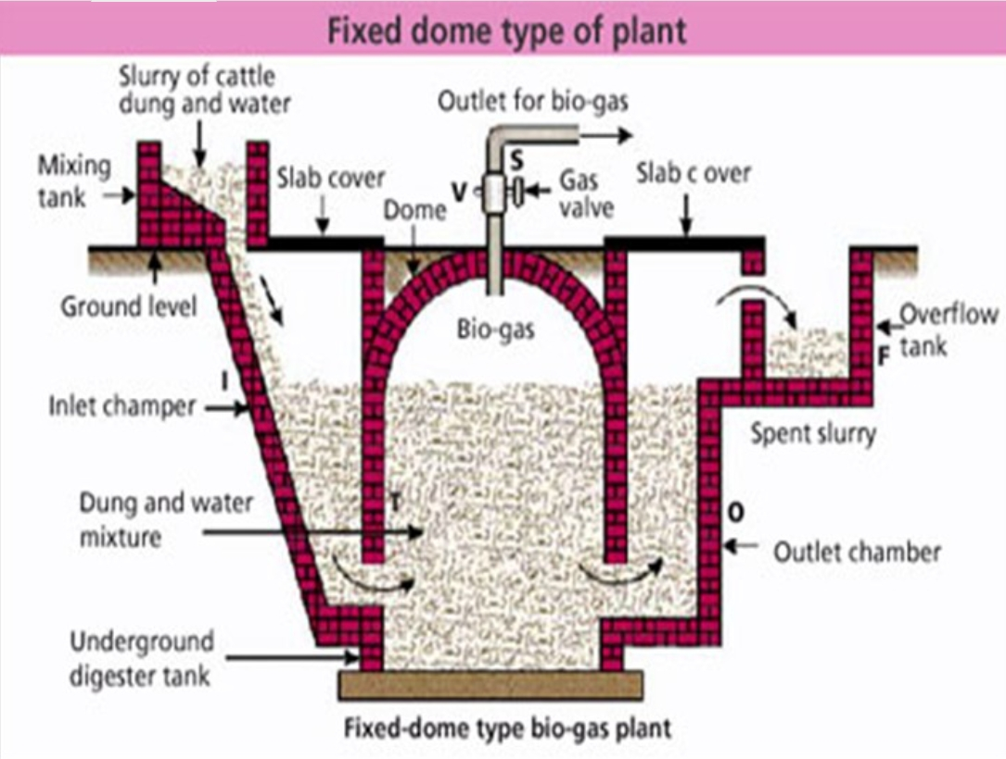

Slide 18
Floating gas holder type of biogas plant
Raw materials require:-
Animal dung
Poultry wastes
Plant wastes ( Husk, grass, weeds etc.)
Human excreta
Industrial wastes(Saw dust, wastes from food processing industries)
Domestic wastes (Vegetable peels, waste food materials)
Principle
Biogas is produced as a result of anaerobic decomposition of biomass in the presence of water.

Slide 19
Construction
The floating gas holder type of biogas plant has the following chambers/ sections:
Mixing Tank - present above the ground level.
Digester tank - Deep underground well-like structure. It is divided into two chambers by a partition wall in between.
It has two long cement pipes:
i) Inlet pipe opening into the inlet chamber for introduction of slurry.
ii) Outlet pipe opening into the overflow tank for removal of spent slurry.
Gas holder - an inverted steel drum resting above the digester. The drum can move up and down i.e., float over the digester. The gas holder has an outlet at the top which could be connected to gas stoves.
Over flow tank - Present above the ground level.

Slide 20
Working
Slurry (mixture of equal quantities of biomass and water) is prepared in the mixing tank.
The prepared slurry is fed into the inlet chamber of the digester through the inlet pipe.
The plant is left unused for about two months and introduction of more slurry is stopped.
During this period, anaerobic fermentation of biomass takes place in the presence of water and produces biogas in the digester.
Biogas being lighter rises up and starts collecting in the gas holder. The gas holder now starts moving up.
The gas holder cannot rise up beyond a certain level. As more and more gas starts collecting, more pressure begins to be exerted on the slurry.

Slide 21
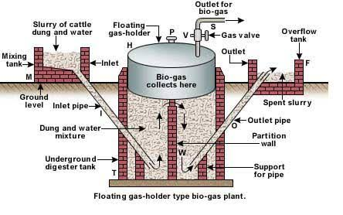

Slide 22
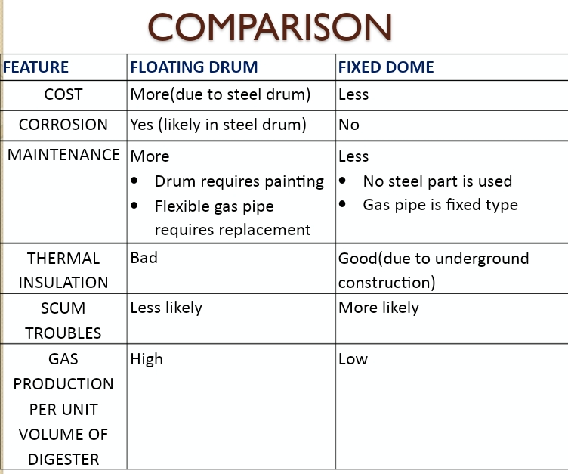

Slide 23
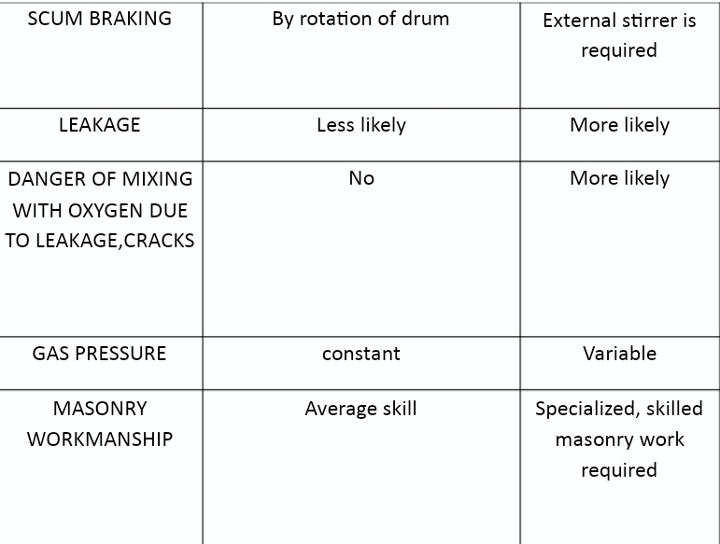

Slide 24
Current status of biogas in India
India is implementing one of the World's largest programme in renewable energy
India has 46 compressed biogas plants with an overall capacity of 272 tonnes/day.
India is the world's second-largest biogas consumer in the world.
Biogas Production in India is equivalent to 5% of the total LPG consumption
India had a total of over five million biogas plants
Maharashtra had the largest number of biogas plants :- 931 thousand plants
Karnataka ranked second with nearly 513 thousand plants.

Slide 25
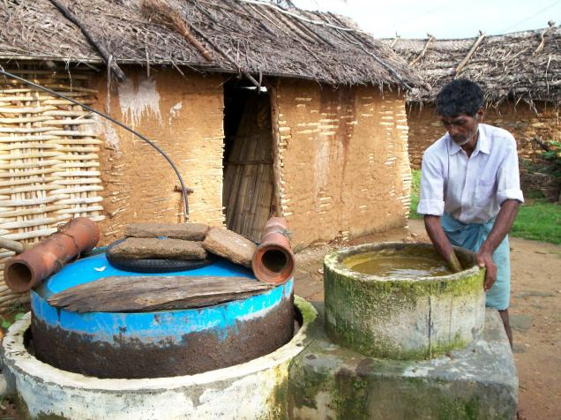
Future plans of India in biogas
India has planned about 5000 compressed biogas (CBG) plants to be set up by 2023 (IBEF, 2021).
In renewable energy sector in India, CBG is in focus due to technology advances.
Global biogas production technologies market is expected to grow at a CAGR of 10.6% up to 2022, worth $10.1 billion.

Slide 26
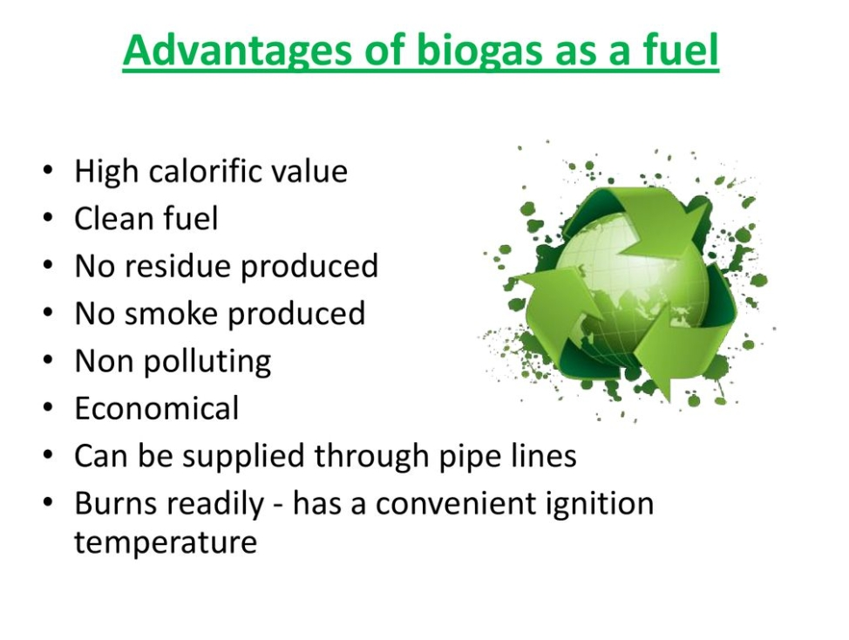

Slide 27
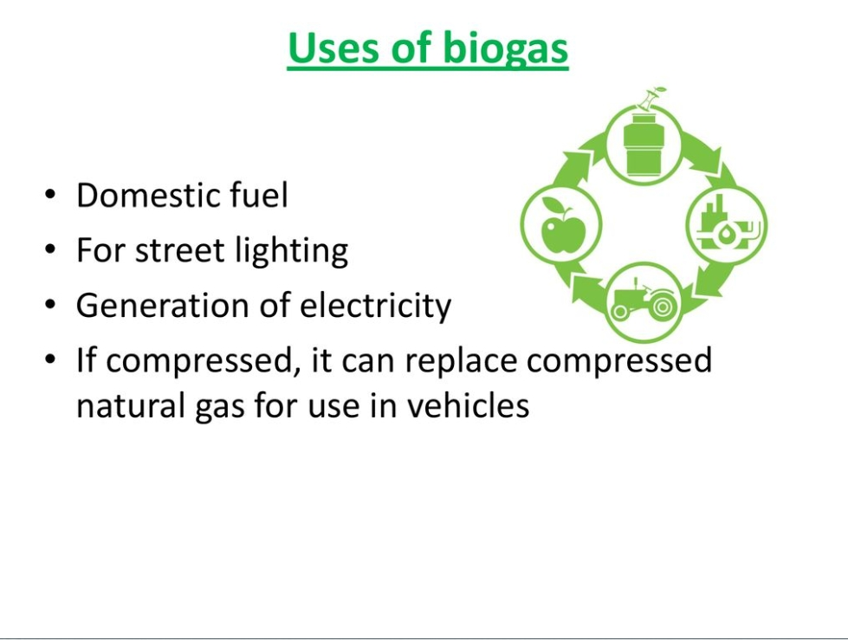

Slide 28
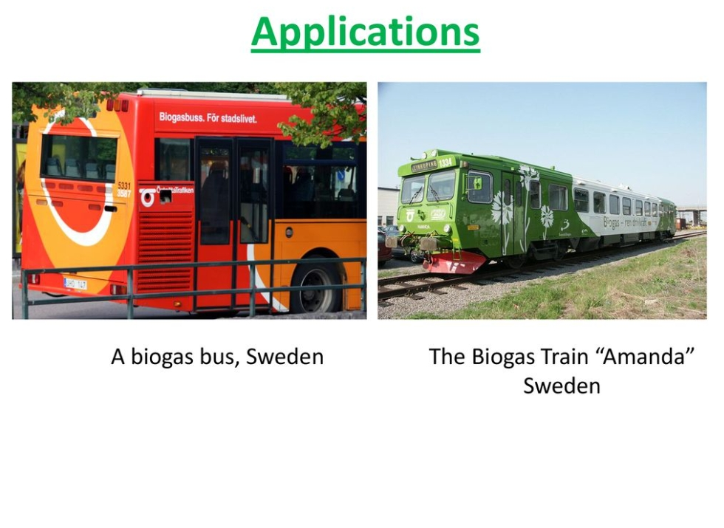

Slide 29
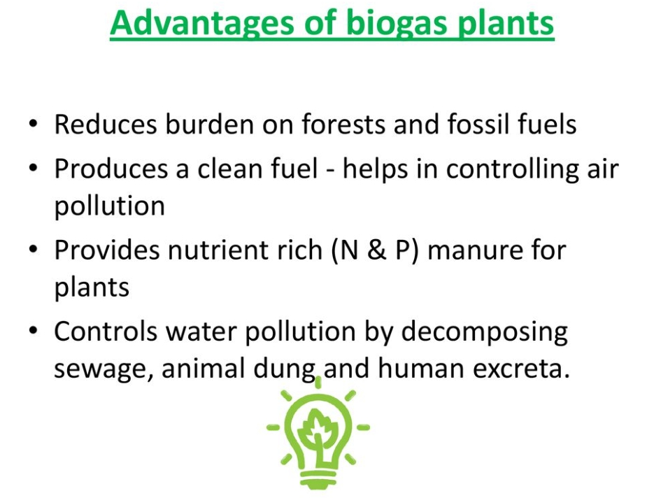

Slide 30
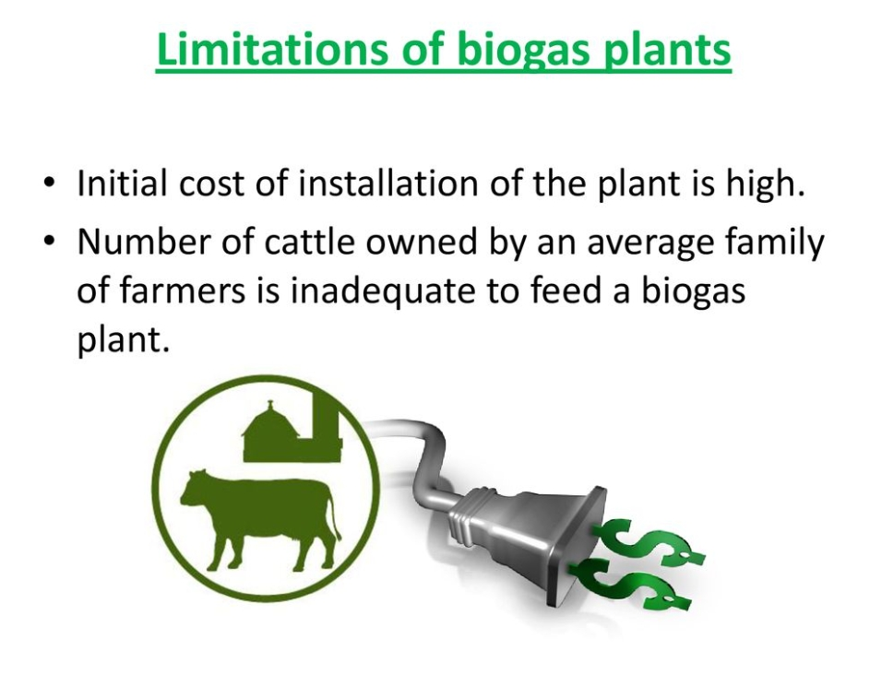

Slide 31
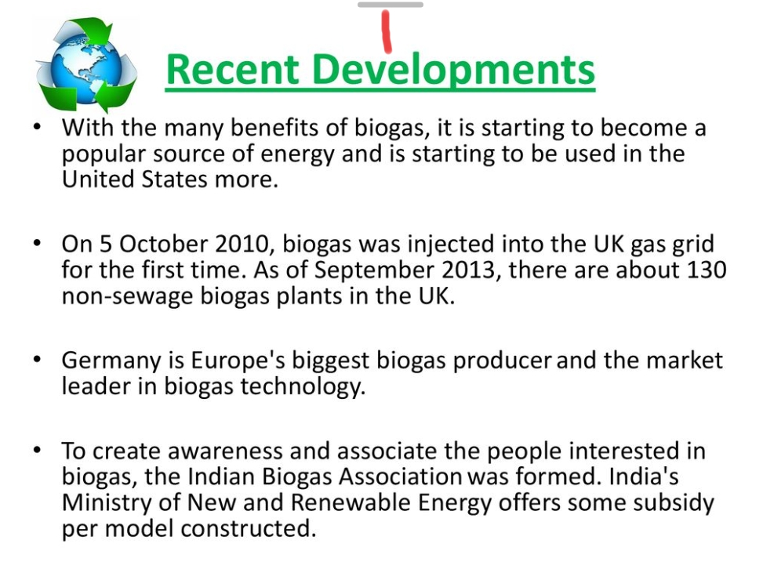

Slide 32
